Slide 1
Intro to Cloud Computing CS4037 (BCS-6A) Lecture 09
Danyal Farhat
FAST School of Computing
NUCES Lahore

Slide 2
Module 5: Networking and Content Delivery
AWS Academy Cloud Foundations

Slide 3
Section 4: VPC security
Module 5: Networking and Content Delivery

Slide 4
Security Groups
A security group acts as a virtual firewall for your instance
Controls inbound and outbound traffic
Act at the instance level, not the subnet level
Each instance in a subnet in your VPC can be assigned to a different set of security groups.
At the most basic level, a security group is a way for you to filter traffic to your instances

Slide 5


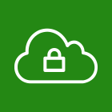



Security groups (1 of 2)
AWS Cloud
Region
Availability Zone
VPC: 10.0.0.0/16
Public subnet:10.0.1.0/24
Security group
Security groups act at the instance level.
Private subnet: 10.0.2.0/24
Security group

Slide 6
Security groups (2 of 2)
Security groups have rules that control inbound and outbound instance traffic.
Default security groups deny all inbound traffic and allow all outbound traffic.
Security groups are stateful.
Inbound
Source | Protocol | Port Range | Description
sg-xxxxxxxx | All | All | Allow inbound traffic from network interfaces assigned to the same security group.
Outbound
Destination | Protocol | Port Range | Description
0.0.0.0/0 | All | All | Allow all outbound IPv4 traffic.
::/0 | All | All | Allow all outbound IPv6 traffic.

Slide 7
Custom security group examples
You can specify allow rules, but not deny rules.
All rules are evaluated before the decision to allow traffic.
Inbound
Source | Protocol | Port Range | Description
0.0.0.0/0 | TCP | 80 | Allow inbound HTTP access from all IPv4 addresses
0.0.0.0/0 | TCP | 443 | Allow inbound HTTPS access from all IPv4 addresses
Your network's public IPv4 address range | TCP | 22 | Allow inbound SSH access to Linux instances from IPv4 IP addresses in your network (over the internet gateway)
Outbound
Destination | Protocol | Port Range | Description
The ID of the security group for your Microsoft SQL Server database servers | TCP | 1433 | Allow outbound Microsoft SQL Server access to instances in the specified security group

Slide 8
Network Access Control Lists
A network ACL is an optional layer of security for your Amazon VPC.
Acts as a firewall for controlling traffic in and out of one or more subnets.
To add another layer of security to your VPC, you can set up network ACLs with rules that are similar to your security groups.
Each subnet in your VPC must be associated with a network ACL.
If you don't explicitly associate a subnet with a network ACL, the subnet is automatically associated with the default network ACL.
You can associate a network ACL with multiple subnets; however, a subnet can be associated with only one network ACL at a time.
When you associate a network ACL with a subnet, the previous association is removed.

Slide 9

Network Access Control Lists (Network ACLs 1 of 2)
AWS Cloud
Region
Availability Zone
VPC: 10.0.0.0/16
Public subnet:10.0.0.0/24
Network ACLs act at the subnet level.
Private subnet: 10.0.4.0/22

Slide 10
Network Access Control Lists (Network ACLs 2 of 2)
A network ACL has separate inbound and outbound rules, and each rule can either allow or deny traffic.
Default network ACLs allow all inbound and outbound IPv4 traffic.
Network ACLs are stateless.
Inbound
Rule | Type | Protocol | Port Range | Source | Allow/Deny
100 | All IPv4 traffic | All | All | 0.0.0.0/0 | ALLOW
* | All IPv4 traffic | All | All | 0.0.0.0/0 | DENY
Outbound
Rule | Type | Protocol | Port Range | Destination | Allow/Deny
100 | All IPv4 traffic | All | All | 0.0.0.0/0 | ALLOW
* | All IPv4 traffic | All | All | 0.0.0.0/0 | DENY

Slide 11
Custom network ACLs examples
Custom network ACLs deny all inbound and outbound traffic until you add rules.
You can specify both allow and deny rules.
Rules are evaluated in number order, starting with the lowest number.
Inbound
Rule | Type | Protocol | Port Range | Source | Allow/Deny
100 | HTTPS | TCP | 443 | 0.0.0.0/0 | ALLOW
120 | SSH | TCP | 22 | 192.0.2.0/24 | ALLOW
* | All IPv4 traffic | All | All | 0.0.0.0/0 | DENY
Outbound
Rule | Type | Protocol | Port Range | Destination | Allow/Deny
100 | HTTPS | TCP | 443 | 0.0.0.0/0 | ALLOW
120 | SSH | TCP | 22 | 192.0.2.0/24 | ALLOW
* | All IPv4 traffic | All | All | 0.0.0.0/0 | DENY

Slide 12
Security groups versus network ACLs
Attribute | Security Groups | Network ACLs
Scope | Instance level | Subnet level
Supported Rules | Allow rules only | Allow and deny rules
State | Stateful (return traffic is automatically allowed, regardless of rules) | Stateless (return traffic must be explicitly allowed by rules)
Order of Rules | All rules are evaluated before decision to allow traffic | Rules are evaluated in number order before decision to allow traffic

Slide 13

Section 4 key takeaways
Build security into your VPC architecture:
Isolate subnets if possible.
Choose the appropriate gateway device or VPN connection for your needs.
Use firewalls.
Security groups and network ACLs are firewall options that you can use to secure your VPC.

Slide 14

Lab 2: Build Your VPC and Launch a Web Server

Slide 15
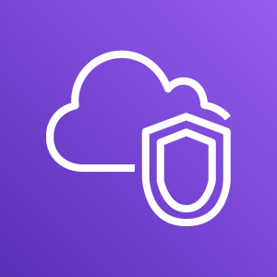

Lab 2: Scenario
In this lab, you use Amazon VPC to create your own VPC and add some components to produce a customized network. You create a security group for your VPC. You also create an EC2 instance and configure it to run a web server and to use the security group. You then launch the EC2 instance into the VPC.
Amazon VPC
Amazon EC2

Slide 16
Lab 2: Tasks
Create a VPC.
Create additional subnets.
Create a VPC security group.
Launch a web server instance.
Security group

Slide 17


Lab 2: Final product
AWS Cloud
Public Route Table
Region
Destination | Target
10.0.0.0/16 | Local
0.0.0.0/0 | Internet gateway
Availability Zone A
Availability Zone B
VPC: 10.0.0.0/16
Internet gateway
Public subnet 1: 10.0.0.0/24
Public subnet 2: 10.0.2.0/24
Security group
NAT gateway
Private Route Table
Web server
Destination | Target
10.0.0.0/16 | Local
0.0.0.0/0 | NAT gateway
Private subnet 1: 10.0.1.0/24
Private subnet 2: 10.0.3.0/24

Slide 18


Begin Lab 2: Build Your VPC and Launch a Web Server
~ 30 minutes

Slide 19
Section 5: Amazon Route 53
Module 5: Networking and Content Delivery

Slide 20

Amazon Route 53
Is a highly available and scalable Domain Name System (DNS) web service
Is used to route end users to internet applications by translating names (like www.example.com) into numeric IP addresses (like 192.0.2.1) that computers use to connect to each other
Is fully compliant with IPv4 and IPv6
Connects user requests to infrastructure running in AWS and also outside of AWS
Is used to check the health of your resources
Features traffic flow
Enables you to register domain names
Amazon Route 53

Slide 21


Amazon Route 53 DNS resolution
Requests www.example.com
Checks with Route 53 for IP address
User
Returns IP address 192.0.2.0
DNS resolver
Returns IP address 192.0.2.0
Amazon Route 53

Slide 22
Amazon Route 53 supported routing
Simple routing – Use in single-server environments
Weighted round robin routing – Assign weights to resource record sets to specify the frequency – priority based routing
Latency routing – Help improve your global applications by reducing latency
Geolocation routing – Route traffic based on location of your users
Geoproximity routing – Route traffic based on location of your resources
Failover routing – Fail over to a backup site if your primary site becomes unreachable
Multivalue answer routing – Respond to DNS queries with up to eight healthy records selected at random

Slide 23
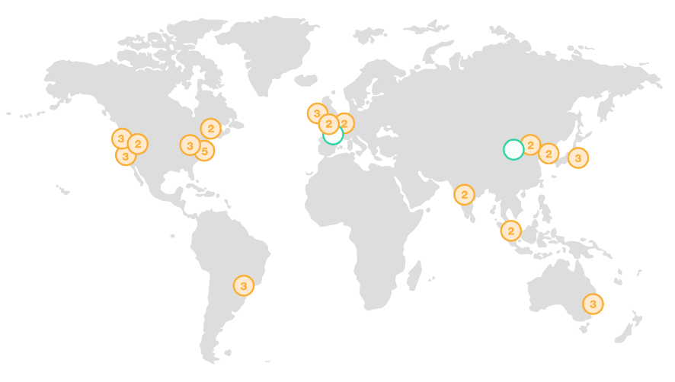
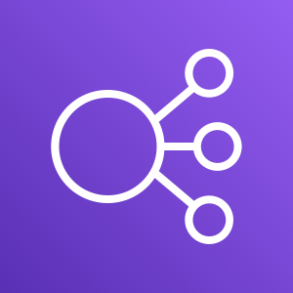
Use case: Multi-region deployment
Amazon Route 53
some-elb-name.us-west-2.elb.amazonaws.com
User
some-elb-name.ap-southeast-2.elb.amazonaws.com
Name | Type | Value
example.com | ALIAS | some-elb-name.us-west-2.elb.amazonaws.com
example.com | ALIAS | some-elb-name.ap-southeast-2.elb.amazonaws.com

Slide 24
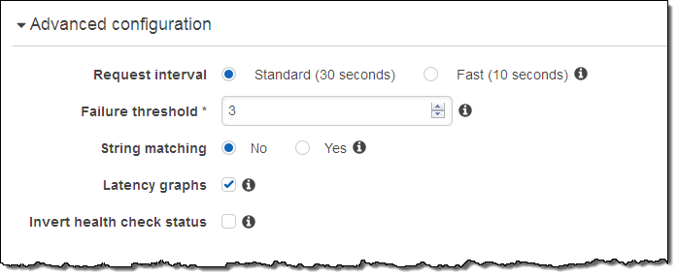
Amazon Route 53 DNS failover
Improve the availability of your applications that run on AWS by:
Configuring backup and failover scenarios for your own applications
Enabling highly available multi-region architectures on AWS
Creating health checks to monitor the health and performance of your web applications

Slide 25

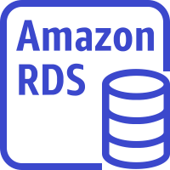

DNS failover for a multi-tiered web application
Record Sets
CNAME www
elastic_load_balancer Routing Policy = Failover
Record Type = Primary
Amazon S3 website Routing Policy = Failover
Record Type = Secondary
AWS Cloud
Availability Zone A
Availability Zone B
Auto Scaling group
Amazon EC2
Amazon EC2
Primary
User
Amazon Relational Database Service (Amazon RDS)
instance
Amazon Relational Database Service (Amazon RDS)
instance
Amazon Route 53
Secondary
Amazon S3 static website

Slide 26
Section 5 key takeaways
Amazon Route 53 is a highly available and scalable cloud DNS web service that translates domain names into numeric IP addresses.
Amazon Route 53 supports several types of routing policies.
Multi-Region deployment improves your application’s performance for a global audience.
You can use Amazon Route 53 failover to improve the availability of your applications.

Slide 27
Section 6: Amazon CloudFront
Module 5: Networking and Content Delivery

Slide 28
Content delivery and network latency
One of the challenges of network communication is network performance.
When you browse a website or stream a video, your request is routed through many different networks to reach an origin server.
The origin server (or origin) stores the original, definitive versions of the objects (webpages, images, and media files).
The number of network hops and the distance that the request must travel significantly affect the performance and responsiveness of the website.
Further, network latency is different in various geographic locations. For these reasons, a content delivery network might be the solution.

Slide 29

Content delivery and network latency
Hop
Router
Hop
Hop
Origin server
Hop
Router
Router
Hop
Hop
Client
Router
Hop
User

Slide 30
Content delivery network (CDN)
Is a globally distributed system of caching servers
Caches copies of commonly requested files (static content)
Delivers a local copy of the requested content from a nearby cache edge or Point of Presence
Accelerates delivery of dynamic content
Improves application performance and scaling

Slide 31

Amazon CloudFront
Fast, global, and secure CDN service
Global network of edge locations and Regional edge caches
Self-service model
Pay-as-you-go pricing
Amazon CloudFront

Slide 32
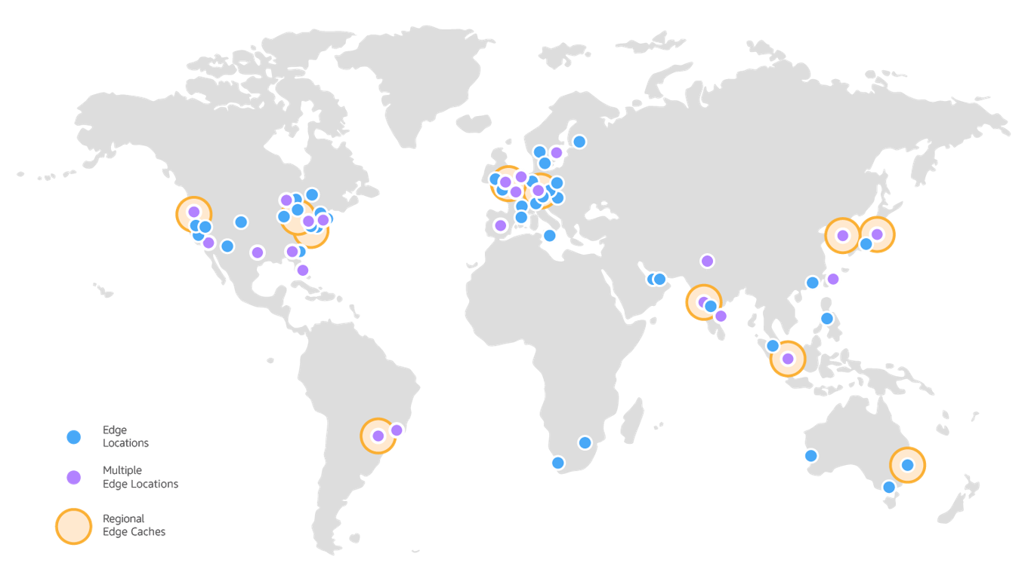
Amazon CloudFront infrastructure
Edge locations
Multiple edge locations
Regional edge caches
Edge locations – Network of data centers that CloudFront uses to serve popular content quickly to customers.
Regional edge cache – CloudFront location that caches content that is not popular enough to stay at an edge location. It is located between the origin server and the global edge location.

Slide 33
Amazon CloudFront benefits
Fast and global
Security at the edge
Highly programmable
Deeply integrated with AWS
Cost-effective

Slide 34
Amazon CloudFront pricing
Data transfer out
Charged for the volume of data transferred out from Amazon CloudFront edge location to the internet or to your origin.
HTTP(S) requests
Charged for number of HTTP(S) requests.
Invalidation requests
No additional charge for the first 1,000 paths that are requested for invalidation (cache miss) each month. Thereafter, $0.005 per path that is requested for invalidation.
Dedicated IP custom SSL
$600 per month for each custom SSL certificate that is associated with one or more CloudFront distributions that use the Dedicated IP version of custom SSL certificate support.

Slide 35
Section 6 key takeaways
A CDN is a globally distributed system of caching servers that accelerates delivery of content.
Amazon CloudFront is a fast CDN service that securely delivers data, videos, applications, and APIs over a global infrastructure with low latency and high transfer speeds.
Amazon CloudFront offers many benefits.

Slide 36
Module wrap-up
Module 5: Networking and Content Delivery

Slide 37
Module summary
In summary, in this module you learned how to:
Recognize the basics of networking
Describe virtual networking in the cloud with Amazon VPC
Label a network diagram
Design a basic VPC architecture
Indicate the steps to build a VPC
Identify security groups
Create your own VPC and added additional components to it to produce a customized network
Identify the fundamentals of Amazon Route 53
Recognize the benefits of Amazon CloudFront

Slide 38
Additional resources
Amazon VPC Overview pag: https://docs.aws.amazon.com/vpc/latest/userguide/what-is-amazon-vpc.html
Amazon Virtual Private Cloud Connectivity Options whitepaper: https://docs.aws.amazon.com/whitepapers/latest/aws-vpc-connectivity-options/introduction.html
One to Many: Evolving VPC Design AWS Architecture blog post: https://aws.amazon.com/blogs/architecture/one-to-many-evolving-vpc-design/
Amazon VPC User Guide: https://docs.aws.amazon.com/vpc/latest/userguide/what-is-amazon-vpc.html
Amazon CloudFront overview page: https://aws.amazon.com/cloudfront/?nc=sn&loc=1

Slide 39
Thank you
All trademarks are the property of their owners.

